Slide 1
MICRO CONTROLLER
Module-4
By,
Lekshmi Suresh
AP in ECE

Slide 2
Internet of Things(IOT)
Internet of Things (IoT) consists of things which have unique identities and they are connected to Internet.
Some devices which have already been exist those are computer networking, 4G-enabled smart mobile phones, have unique identities and are connected to the Internet

Slide 3
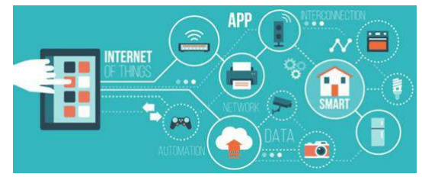
Internet of Things (IoT) is the collection of physical objects
Embedded with software, network, & sensors allows the objects for collection and exchange of data

Slide 4
IoT makes every device "smart," by improving the power of data collection, AI, and networking.
IOT allows things for communication & data exchange when executes meaningful information.

Slide 5
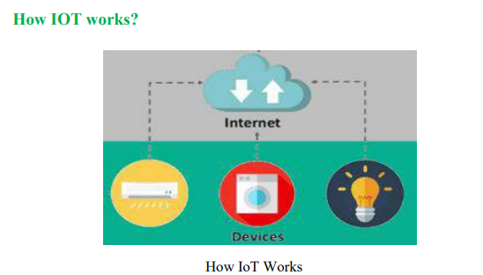
Smart phones, smart refrigerator, smart watch, electronic appliances like smart TV, Washing Machine which help us to communicate with IOT platform.

Slide 6
IoT system consists of the following components:
1) Sensors/Devices:
a)A device has different types of sensors that perform multiple tasks besides sensing
b) A device has different types of sensors that perform multiple tasks besides sensing
2) Connectivity:
The collected data is sent to a cloud infrastructure
This communication channel includes mobile networks, Bluetooth, WI-FI, WAN, etc.

Slide 7
3)Data Processing: After data collected, it gets to the cloud; the software that performs processing on these collected data.
4) User Interface: The information can be send to end-user by triggering alarms on phones or by the notification send through email or text message

Slide 8
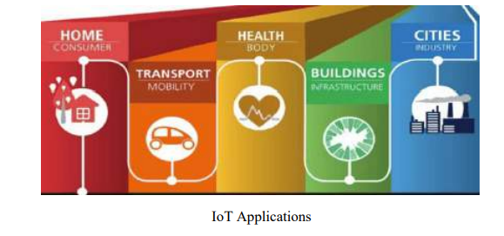

Slide 9
Advantages of IoT
Technical Optimization
Improved Data Collection
Reduced Waste
Improved Customer Engagement

Slide 10
Characteristics of IOT
Dynamic & Self-Adapting
Self-Configuring
Interoperable Communication Protocols
Unique Identity
Integrated into Information Network

Slide 11
IOT Architecture
Architecture refers to a structured framework depicting the tangible components of a network, their operational arrangement and setup, underlying principles and structures
IoT architecture comprises of a collection of devices, sensors, actuators, end users, cloud services and most importantly various communication layers and IoT protocols

Slide 12
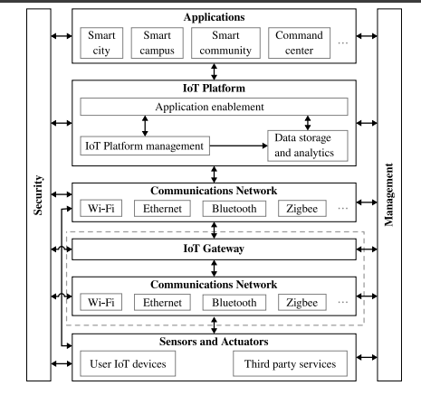

Slide 13
We can define a more complete reference architecture that is capable of abstracting well the architecture of most of the stateof-the-art IoT platforms
Such an architecture contains seven different parts:
sensors and actuators
IoT platform
communications network
IoT gateway
applications
management
security

Slide 14
SENSORS:Sensors are hardware devices that measure physical parameters from the environment (e.g., temperature or humidity) or from other systems (e.g., a current meter).
Actuators are hardware devices that carry out actions based on IoT requests (e.g., any device that can be turned on or off).
(a) user IoT devices, which are physical devices deployed by the user, e.g., temperature sensors;
(b) third-party services, usually available through a representational state transfer (REST) APIs that provides data on request, e.g., meteorological data provided by government agencies.

Slide 15
2. Communications network:
The communications network must provide the physical, link, and network layers according to the Open System Interconnection (OSI) model
The network layer is responsible for providing packet forwarding and routing.

Slide 16
Some of the most common protocols are the following:
• IPv4: The Internet protocol (IP) version 4 (IPv4) is currently the most used of the IP versions, which are used to address the Internet. It was first implemented in 1983 and uses 32 bit addresses, thus having a total of 2 32 unique addresses, of which 2 24 are reserved for used in private local area networks (LANs). However, due to its low number of addresses, available IPv4 addresses for the Internet are almost depleted. This is the so-called IPv4 address exhaustion problem.
• IPv6: To solve the address exhaustion problem, the IP version 6 (IPv6) was developed. IPv6 uses 128 bit addresses, thus being the number of addresses much larger than the one of IPv4.
• 6LoWPAN: The IPv6 over Low-Power Wireless Personal Area Networks was developed by the Internet Engineering Task Force (IETF) to make an adaptation layer that allows IPv6 with the low-rate wireless personal area networks defined by the IEEE 802.15.4 standard

Slide 17
3. IoT gateway
Different IoT devices may use different communication networks, data layer protocols, data formats and, in many cases, the IoT platform may lack direct support for some of these.
a middleware component called ‘‘gateway’’ or ‘‘edge gateway’’ may be introduced between the IoT platform and the IoT devices

Slide 18
4. IoT platform
we consider three fundamental building blocks:
device management and connectivity
data storage and analytics, and
application enablement

Slide 19
5. Applications
An application is a software component that performs a specific task reading data captured by the sensors and/or controlling the actuators.
Examples of applications are:
• A GUI graph that displays the data from a sensor over time.
• A GUI button that allows the user to turn on or off some device.
• A rule that automatically turns on or off a device based on the values provided by another sensor

Slide 20
6. Security
The security block is responsible for ensuring confidentiality, integrity and availability.
User authentication,
user privacy,
access control,
monitoring and auditing of security events,
and management of keys and certificates, are among its functions

Slide 21
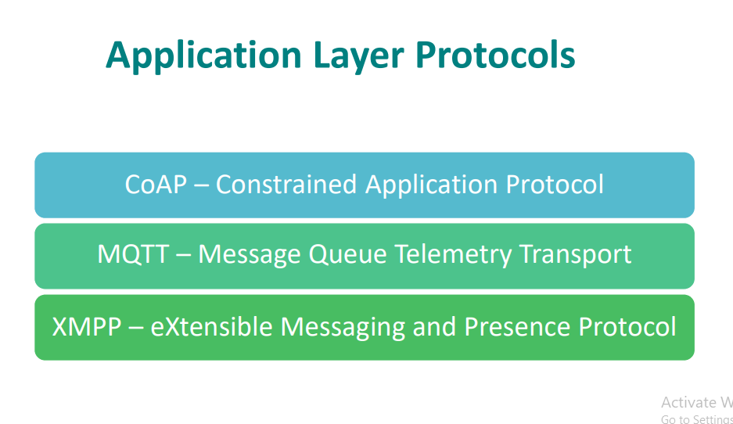

Slide 22
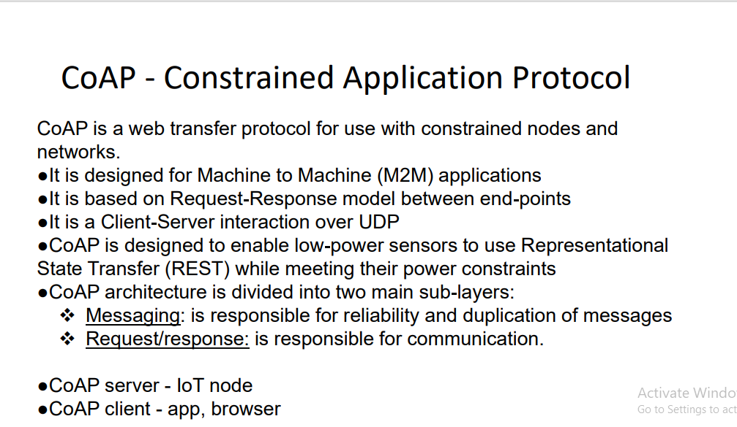

Slide 23
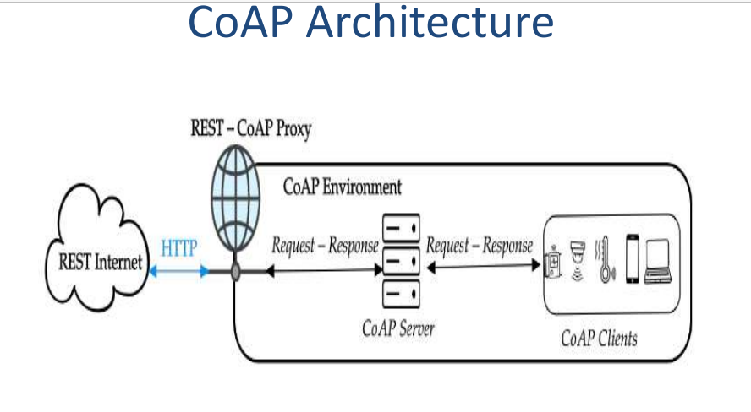

Slide 24
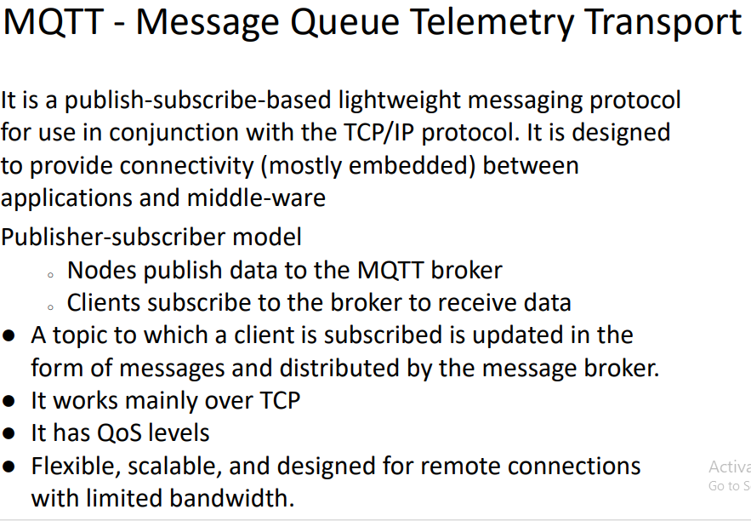

Slide 26
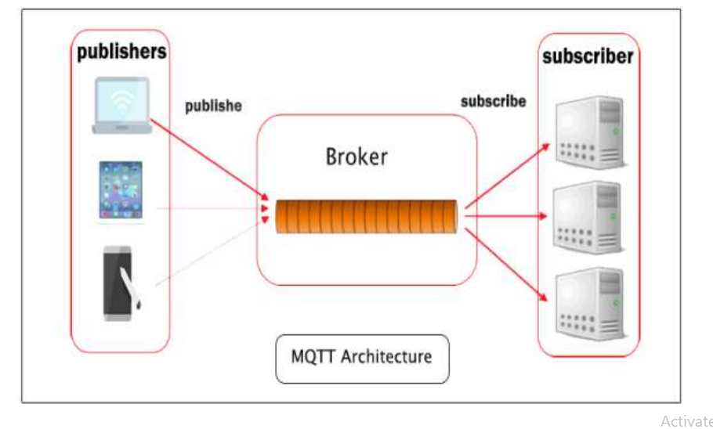

Slide 27
IoT Communication Parameters
Understanding the limitations and characteristics of a communication technology is essential before implementing an IoT solution
A communication protocol is a set of rules and procedures that enables network nodes to exchange information in a systematic and dependable manner.
Some of the major parameters used to evaluate an IoT communication protocol are described below.

Slide 28
LoRa Communication
LoRa communication enables IoT devices to transmit small data payloads over long distances with low power consumption
LoRa is a radio technology rather than a complete network.
LoRaWAN provides managed network connectivity

Slide 29
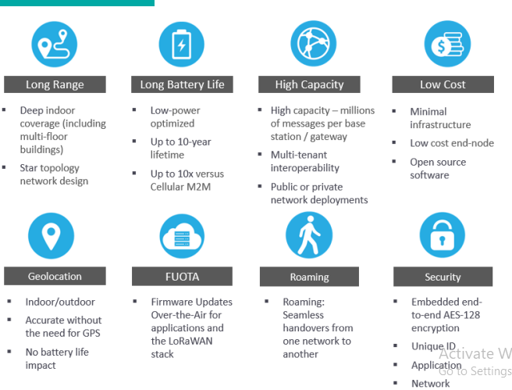

Slide 30
LoRa is based on unique modulation scheme known as Chirp Spread Spectrum modulation (CSS)
A chirp, often called a sweep signal, is a tone in which the frequency increases (up-chirp) or decreases (down-chirp) with time. These chirp signals are used as carrier signals where a message is encoded on.

Slide 31
Core Features of LoRa and LoRaWAN
LoRa-Long Range
Spreading Factor (SF)
Transmission Power (TP)
Coding Rate (CR)
Carrier Frequency (CF)
Bandwidth (BW)

Slide 32
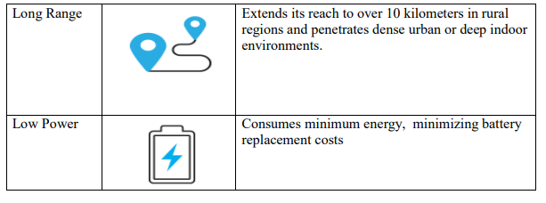
FEATURES of LoRa:

Slide 33
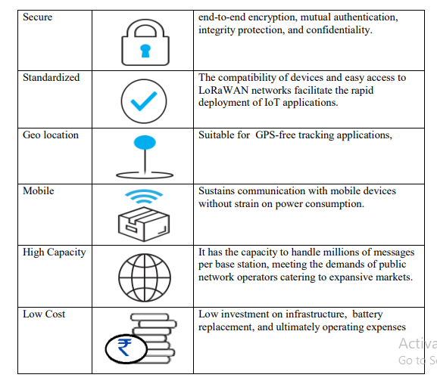

Slide 34
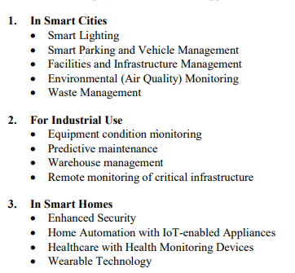
APPLICATIONS

Slide 35
IoT-Based Home Automation System
Home automation, or smart home technology, is a key aspect of the Internet of Things (IoT)
All the devices in the system are assigned a unique IP address so that it can be remotely accessed and controlled from anywhere, anytime
It refers to a system where Home appliances and equipment are interconnected for centralized, efficient management, enhancing user convenience and operational efficiency

Slide 36
Offer full remote control of home environments through mobile applications, cloud platforms, and AI integration
These systems can also send alerts in case of emergencies such as water leaks, gas leaks, fires, or unauthorized access, thereby increasing the security of smart homes

Slide 37
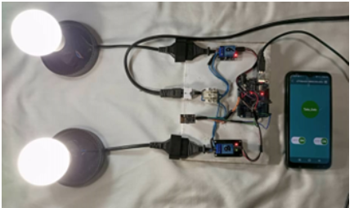

Slide 38
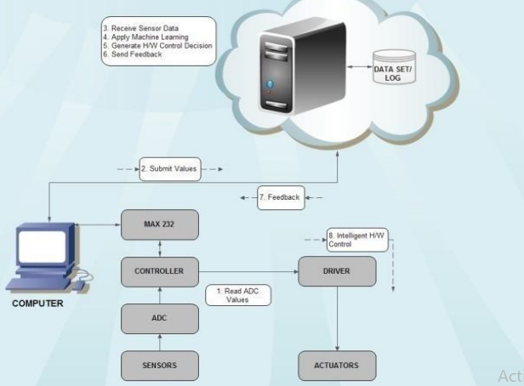

Slide 39
Proposed Home Automation System Functions
The anticipated home mechanization framework has the ability to control the accompanying workings in clients home and watch the accompanying cautions:
•Temperature and humidity
• Gas leakage detection
• Control appliances It can also control following appliances:
• Lights on/off/dim
• Fan on/off
• On/off different appliance
• Leakage of gas

Slide 40
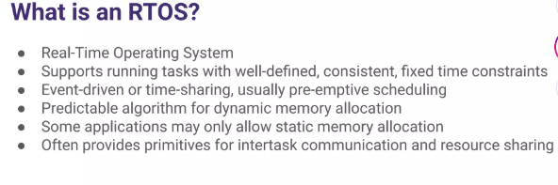

Slide 41
Multitasking Scenarios
Printing information to a display in response to keyboard input
Car Airbag response Braking system
Robotics
Flight system in a drone Control or signal processing algorithms
Soft vs. hard real-time requirements
Soft real-time requirements are those that state a time deadline—but reaching the deadline would not render the system useless.
Hard real-time requirements are those that state a time deadline—and reaching the deadline would result in absolute failure of the system.

Slide 42
The Kernel
The kernel is the core of the operating system and is responsible for managing the system resources and the communication among the hardware and other system services.
Kernel acts as the abstraction layer between system resources and user applications.
Kernel contains a set of system libraries and services.
For a general purpose OS, the kernel contains different services for handling the following

Slide 43
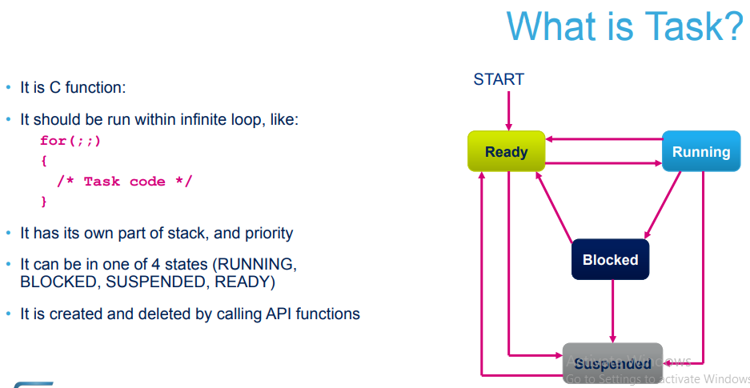

Slide 44
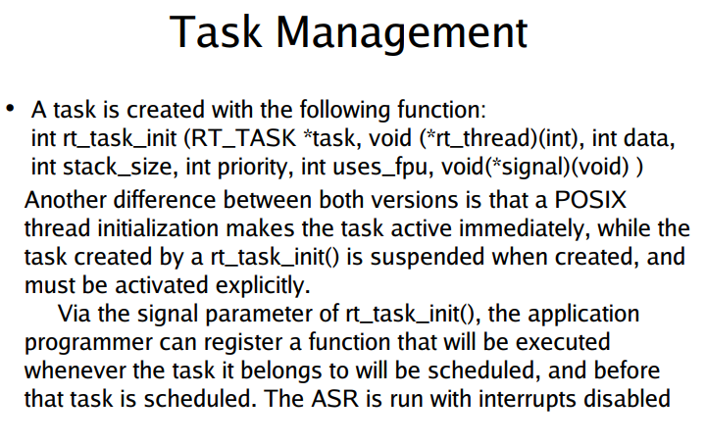

Slide 45
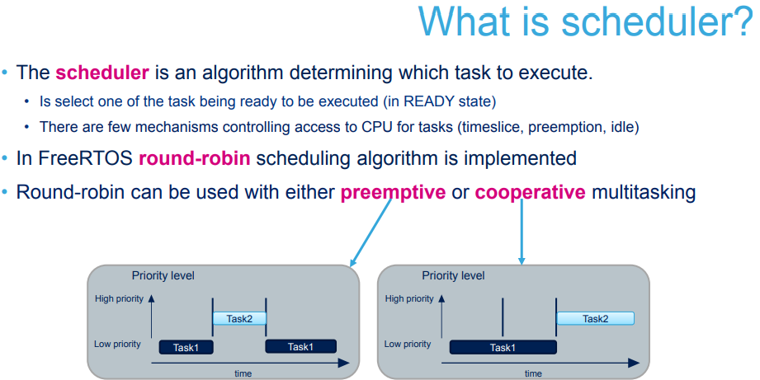

Slide 46
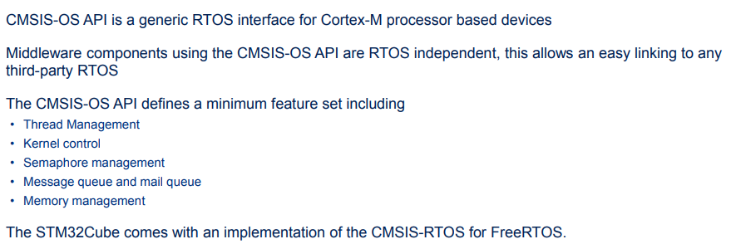

Slide 48
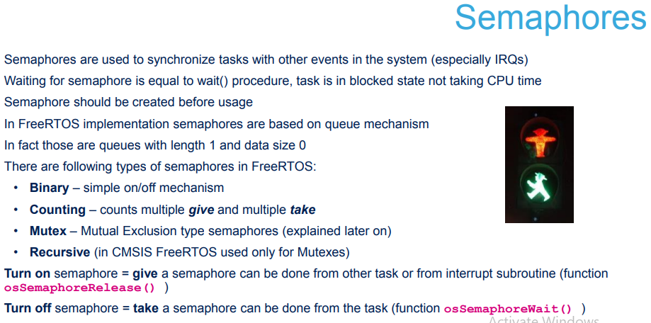

Slide 49
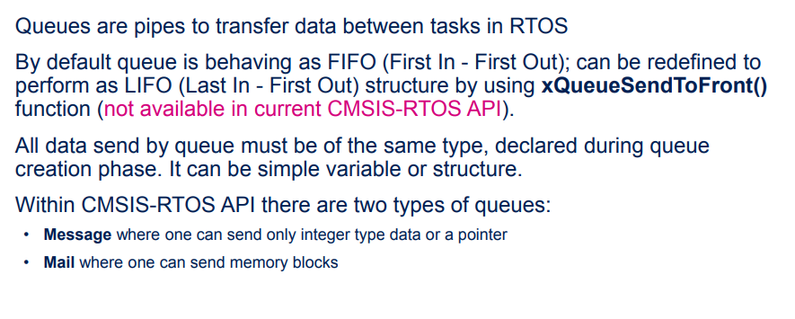
QUEUES

Slide 50
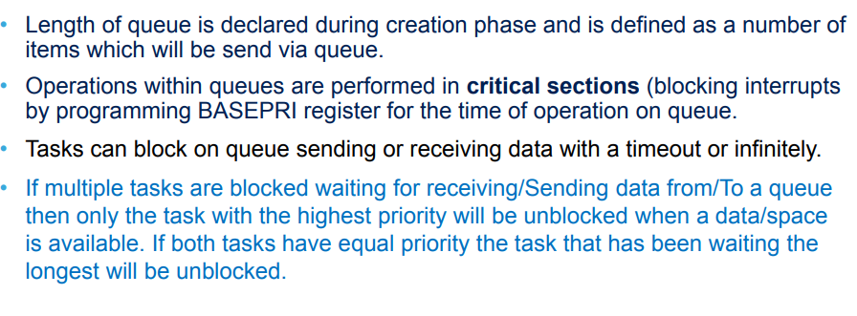

Slide 51
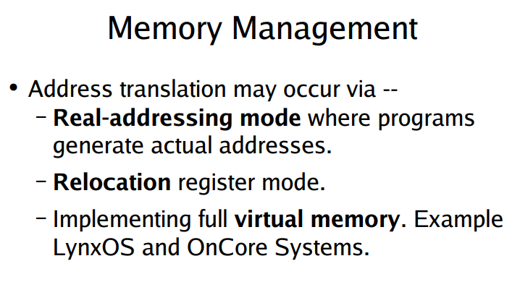

Slide 52
TIMERS,DELAYS…
Software timers are used to schedule the execution of a function at a set time in the future, or periodically with a fixed frequency.
Software timers are implemented by, and are under the control of, the Free RTOS kernel.
They do not require hardware support, and are not related to hardware timers or hardware counters.

Slide 53
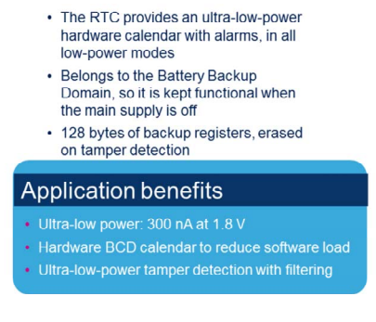
REAL TIME CLOCK(RTC)

Slide 54
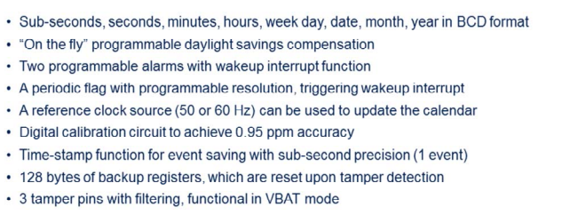

Slide 55
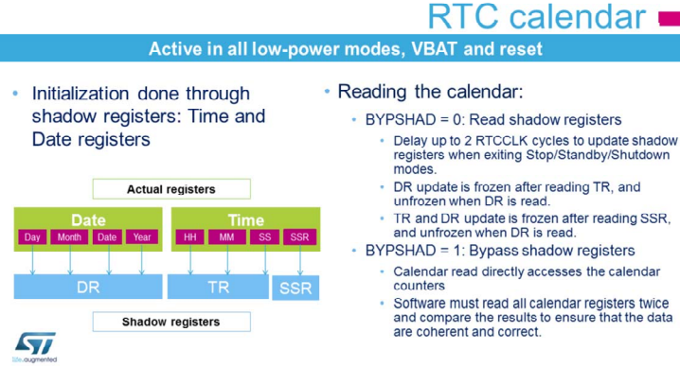

Slide 56
Trust Zone Technology
The Arm Trust Zone technology for Armv8-M partitions the system into two regions: one is secure world and another is non secure world.
Important data that needs protection (such as cryptographic keys) must be placed and processed safely in the secure world .
The location where the code is executed defines its type:
• When the code is executed in secure memory, it is called secure code.
• When the code is executed in non secure memory, it is called non secure code.

Slide 57
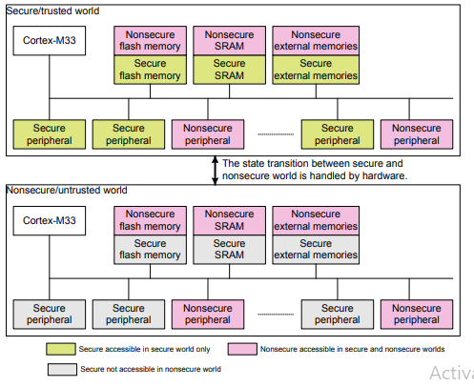
Resource partition between secure and non secure worlds

Slide 58
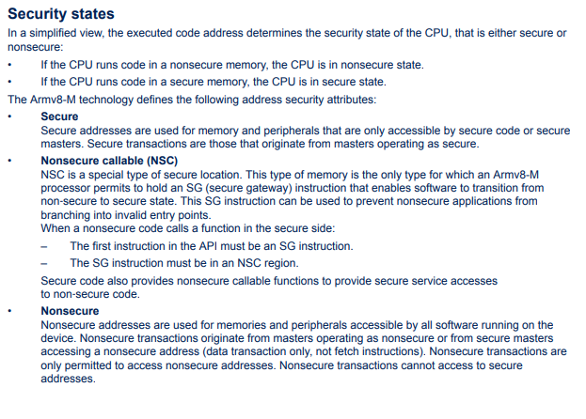

Slide 59
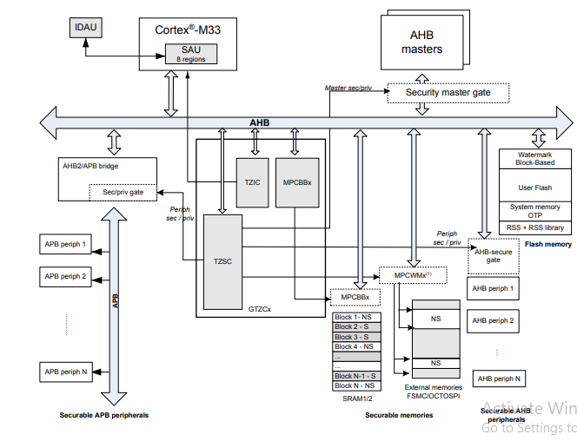
Trust Zone implementation on STM32U5

Slide 60
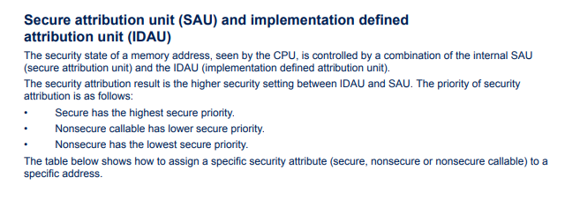

Slide 61
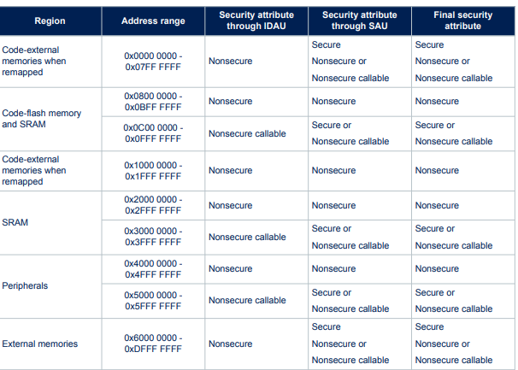
SAU memory map address security attribution on STM32L5, STM32U5, and STM32U3

Slide 62
Code and Memory Optimization
Due to the system split, firmware design can run into memory footprint bloating.
Cross-World Overhead: Inter-world function calls carry runtime overhead because the compiler generates a register clearing sequence to prevent data leaking. Group code modules by dependency to minimize frequent jumping back and forth across the Secure/Non-Secure boundary.
Dual-Project Structuring: Tools like STM32CubeIDE build Trust Zone applications as two linked binaries. Optimize compilation flags

Slide 63
Debugging Strategies and Tools
Hardware Control Points: Authentication states on the STM32U5 determine if a debugger can trace code execution
Secure Debug Enabled: Full access to step through both Secure and Non-Secure zones.
Non-Secure Debug Only: The debugger can only step through Non-Secure code. If the code jumps to a Secure function, the debug probe reads zero values or stalls until the core returns to the Non-Secure state.
Industry Standard Tooling

